Slide 1
Progressive Mobile Application
PMA, an ever responsible mobile-app concept

Slide 2
Problem
App should provide information continuously, but not all.
App runs with network nicely, however…
In source-code you see too many data-sources and Different ways to request data.
No solution for cases, i.e. offline, 3G~2G, airplane-mode etc.

Slide 3
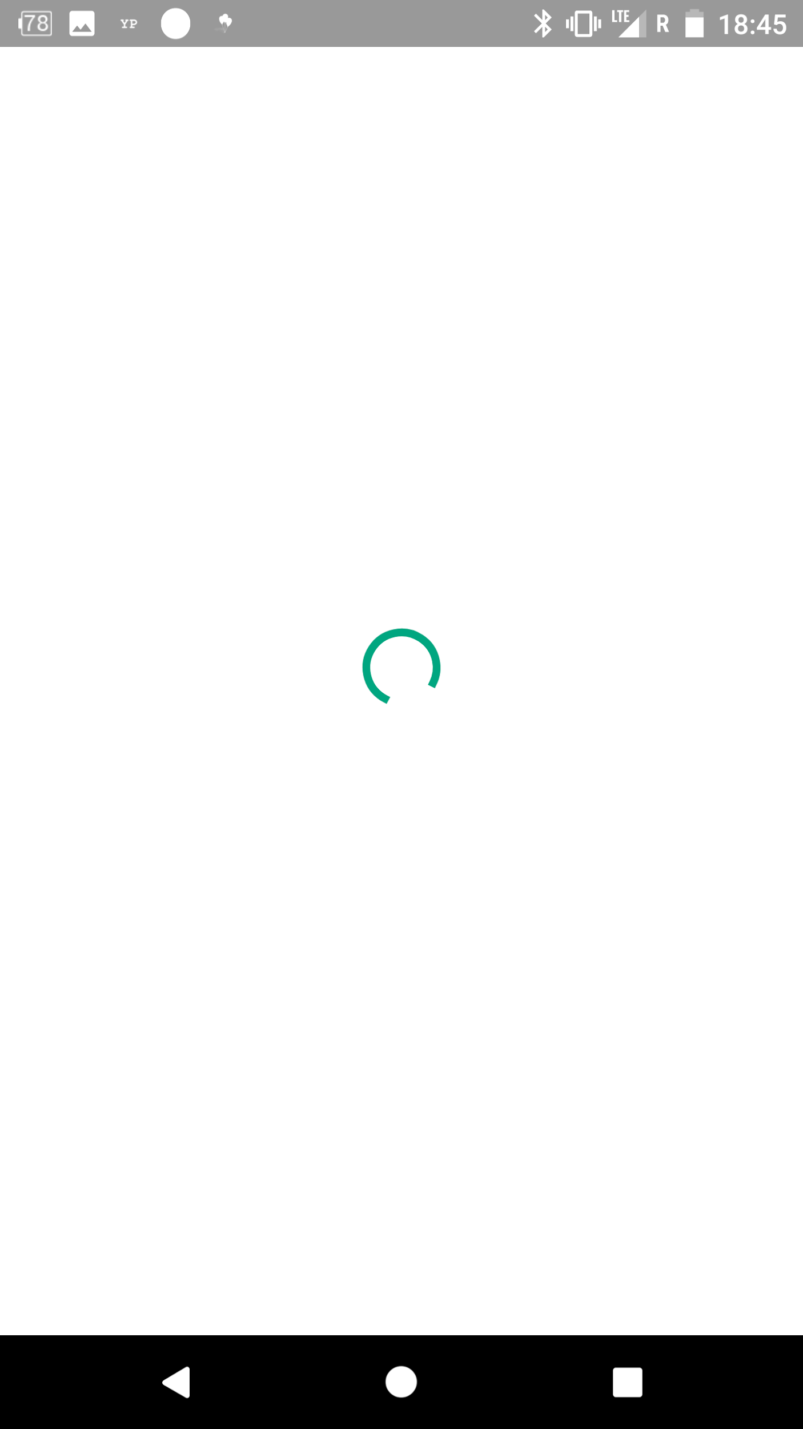
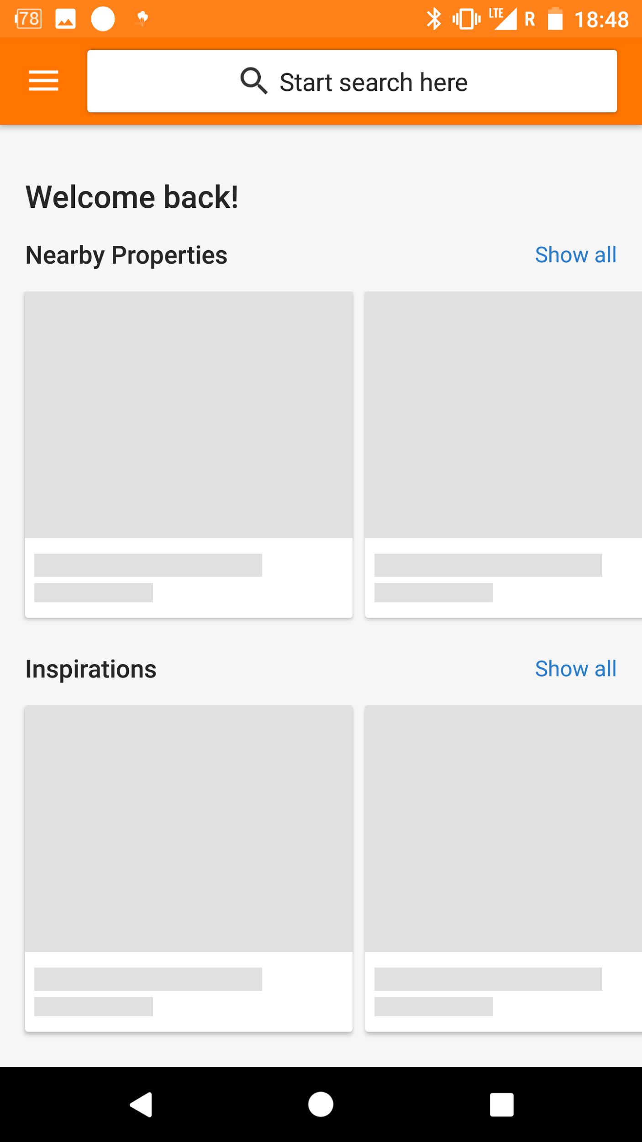
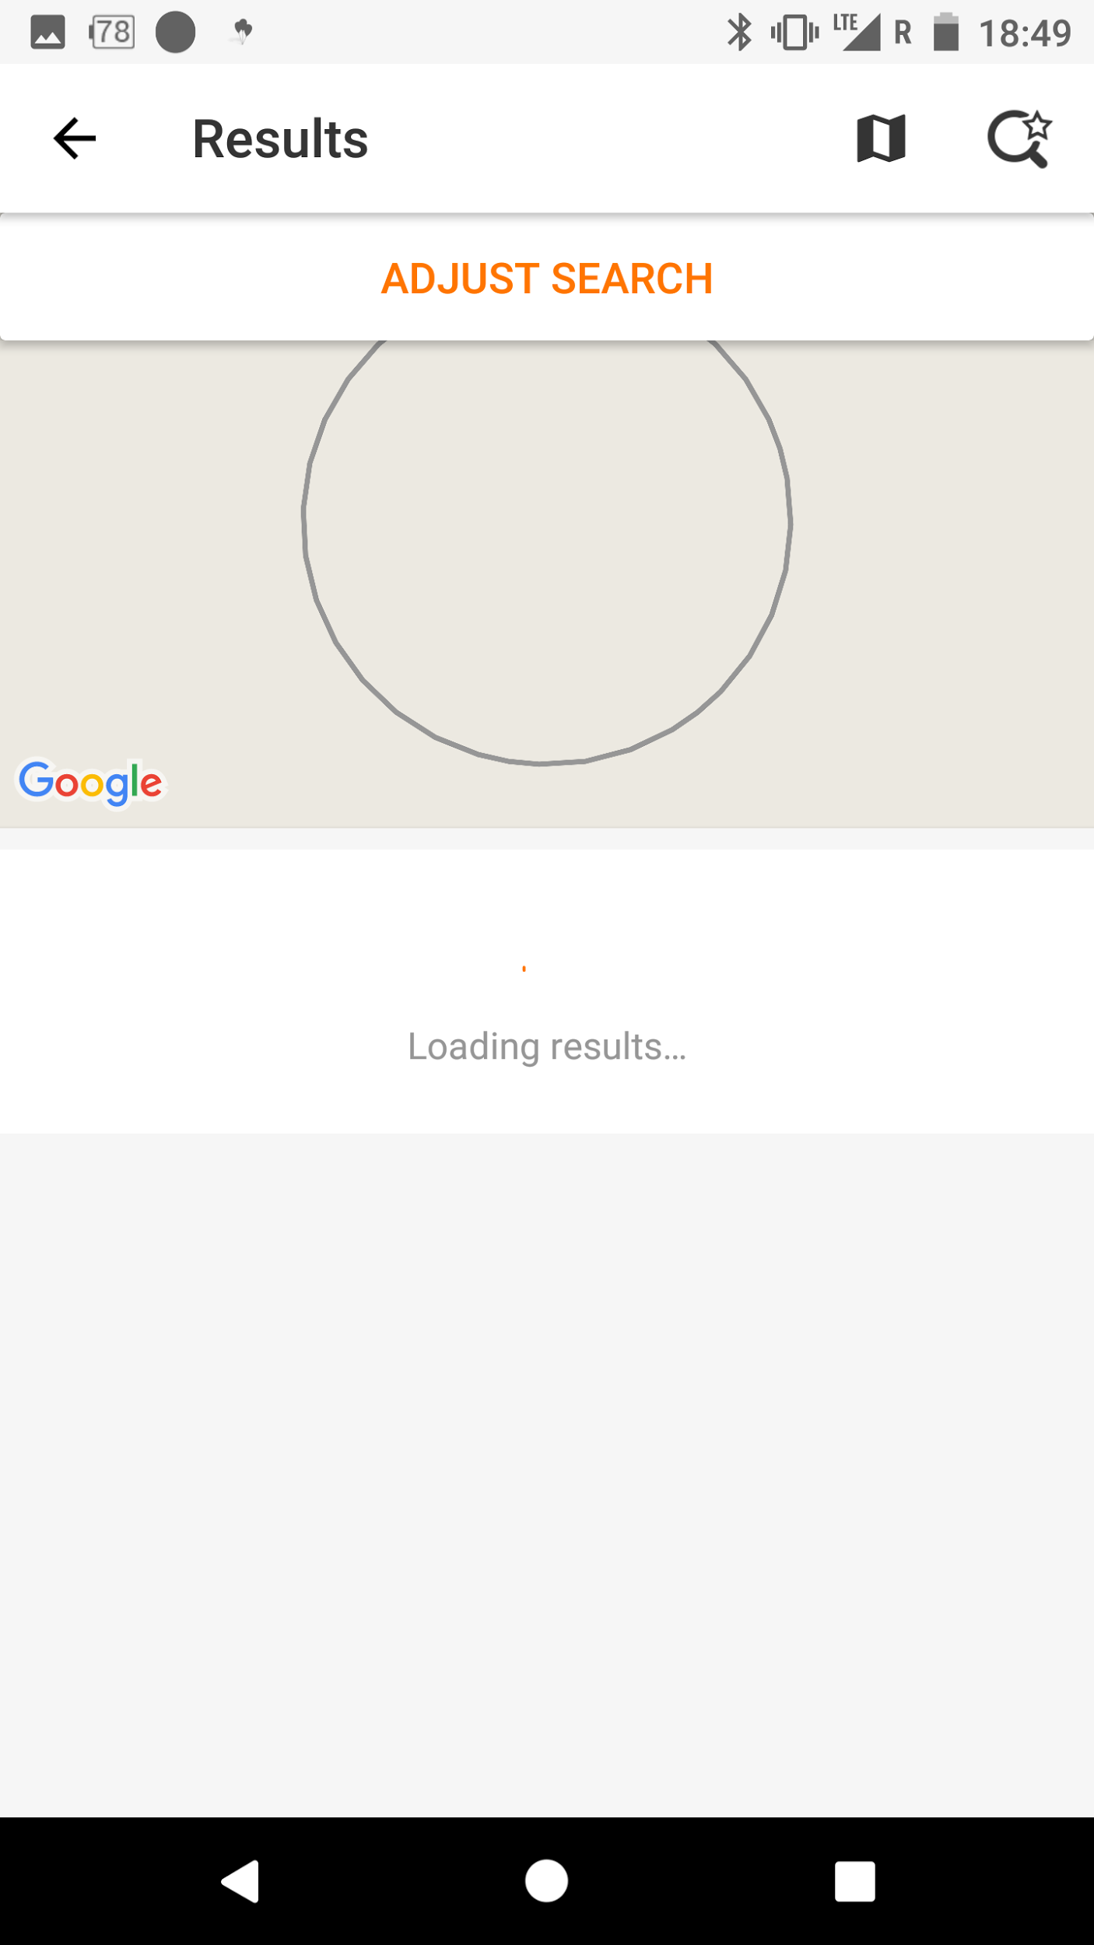


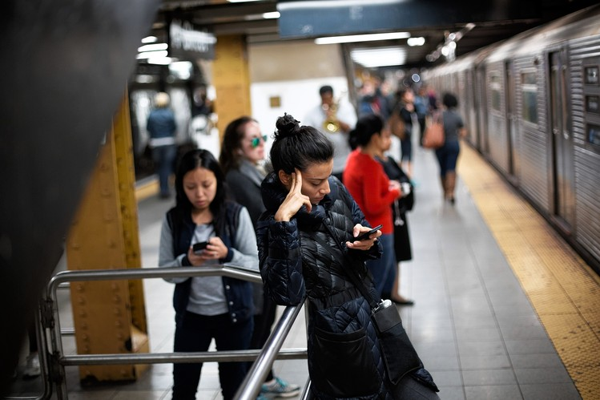
So sad, Bad UX without WiFi

Slide 4


What we need of our apps
stable, clear, correct handling, transparent circumstances, maintainable

Slide 5
Progressive App
Progressive Web App(PWA)
Progressive Mobile App(PMA) ← Our topic

Slide 6
Foundation
Database on device
Data flow being Single & Unitary, either local-only or remote-only
Algorithm for select data
Network context sensitive
More payload on device
More chances for reload-data
Save all http-requests local, remove after reponses return or invalid(Just request)
Data
Network

Slide 7
Data
Local first or. Local only(select data)
Payload for every app-version
Encapsulate bizz-logical with local data(Single & Unitary)

Slide 8

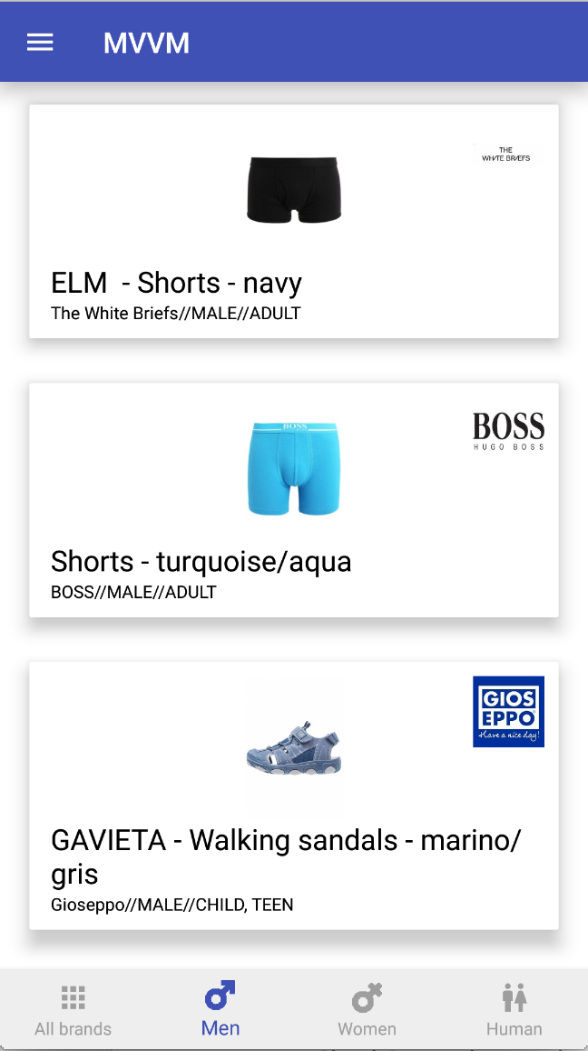

Cloud
App start, showing data from local or payload
Play with local data

Slide 9
Select data with AI
Inspired by Breadth-first search(beginner)
select(x) := f(Local(), Empty-Case(), Error-handling(), Remote())
Neural Networks
select(x) := f(Remote() + Local()+ Empty-Case() + Error-handling())

Slide 10
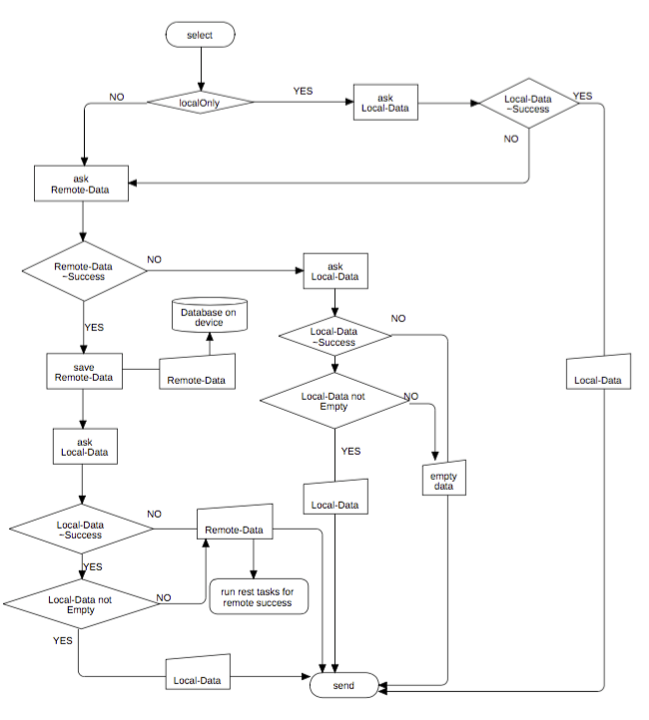

Slide 11
Network
App knows changes of network-status.
App knows little different features for online and offline(inc. airplane).
App knows every http-request, ie. feeds update.
App knows error-cases and handle them with payload.
App knows how to reload data.
… ...

Slide 12


Under way

Slide 13

UX
Refresh bubble
Notification
No Toast
Less Dialog, more Snackbar(Android)
Update background, foreground showing local data(payload)

Slide 14
Who need PMA
No limit, some apps recommend:
News -- more underway, train, subway etc.
Fashion -- photos, medias, in shop, store
Instant-Message(IM) -- continuous
Social-Network(SN) -- underway & continuous

Slide 15
Checklist of PMA(prio+)
Avoid having Large area blank plus endless progress bar.
Avoiding showing empty-state or no-data messages.
....more chances to reload data....
....avoid a huge different between offline, online, airplane-mode ....
….Payload-Data....
….maintainable codes, readability first....

Slide 16
Final
“No Empty, No long-loading”

Slide 17


Thanks
Home Page(doc in progress + ppt): https://github.com/XinyueZ/pma
XinyueZ
@ChrisXYZhao

